Slide 1
MODEL Based Threat & Risk Assessment
TRADES TOOL

Slide 2
TRADES
TRADES – a field-proven Threat and Risk Assessment Methodology
Cybersecurity as a leading design perspective
Based on research of model-driven engineering conducted at Tel Aviv University (TAU-SERI)
TRADES Tool – a tool supporting the implementation of the methodology
Based on open-source infrastructure (Eclipse Modeling Framework)
Easy to use
Easy to extend and tailor

Slide 3
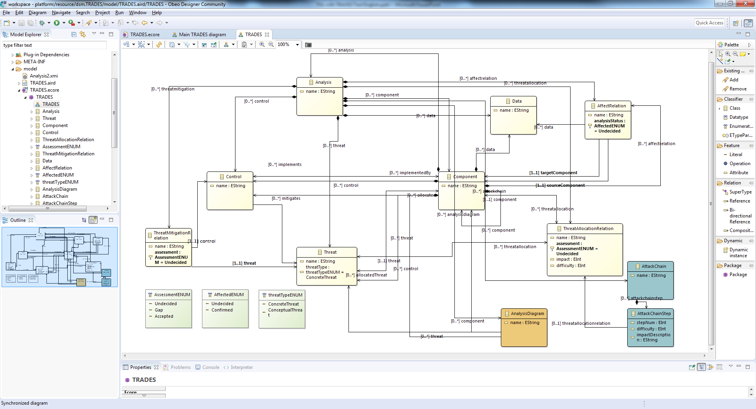
ECORE Metamodel

Slide 4
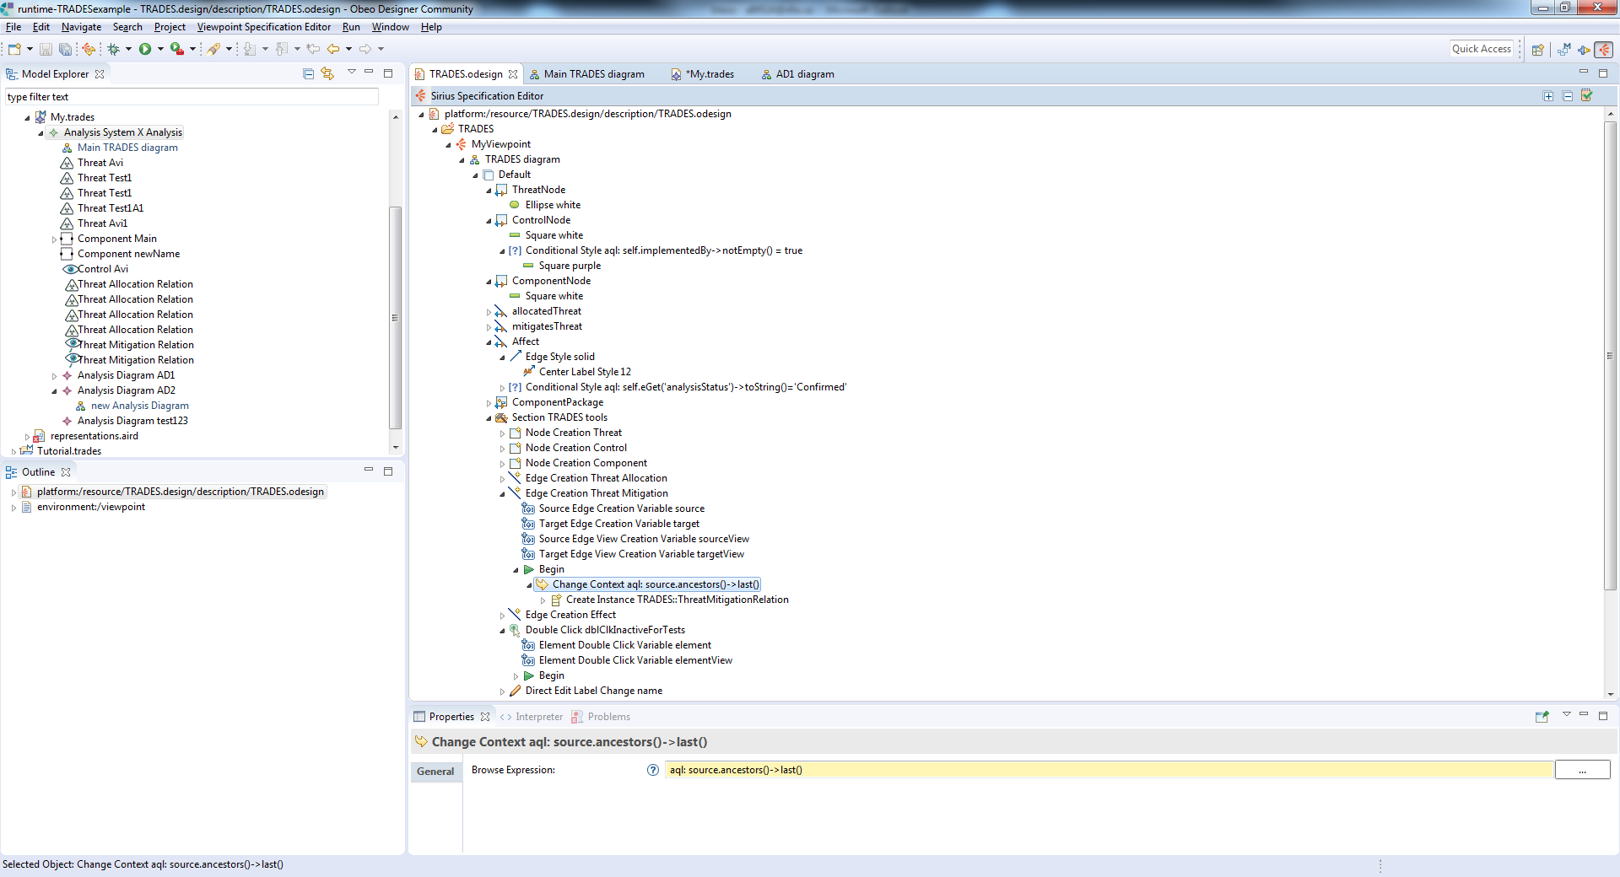
SIRIUS design

Slide 5
Demonstration
System cybersecurity analysis using TRADES Tool

Slide 6
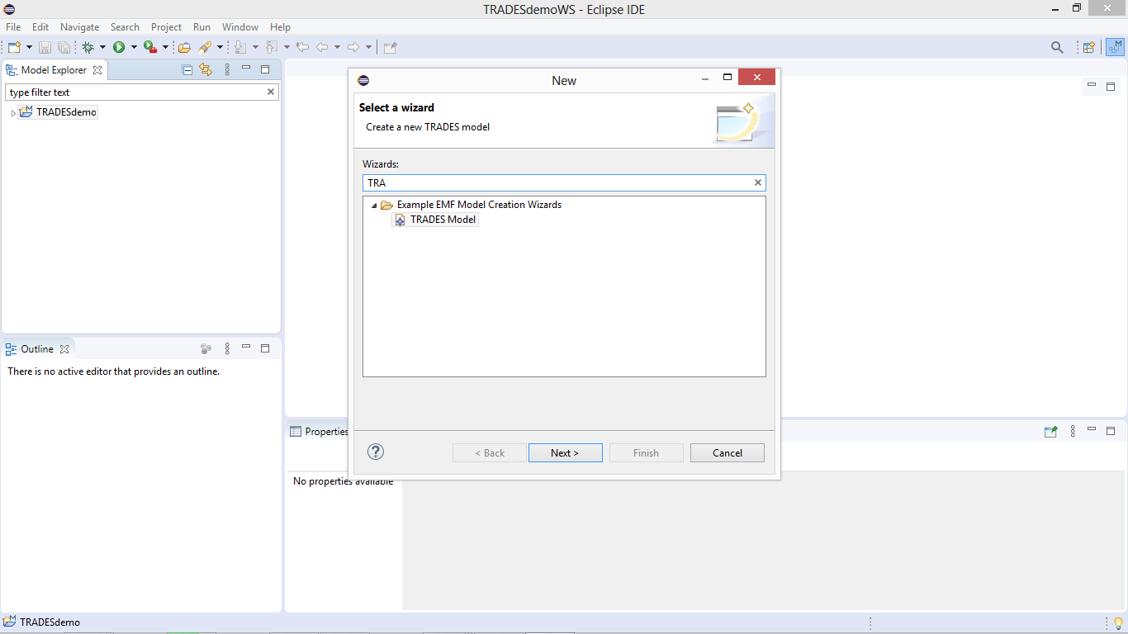
Create a new analysis project (TRADES Model, analysis as model object)

Slide 7
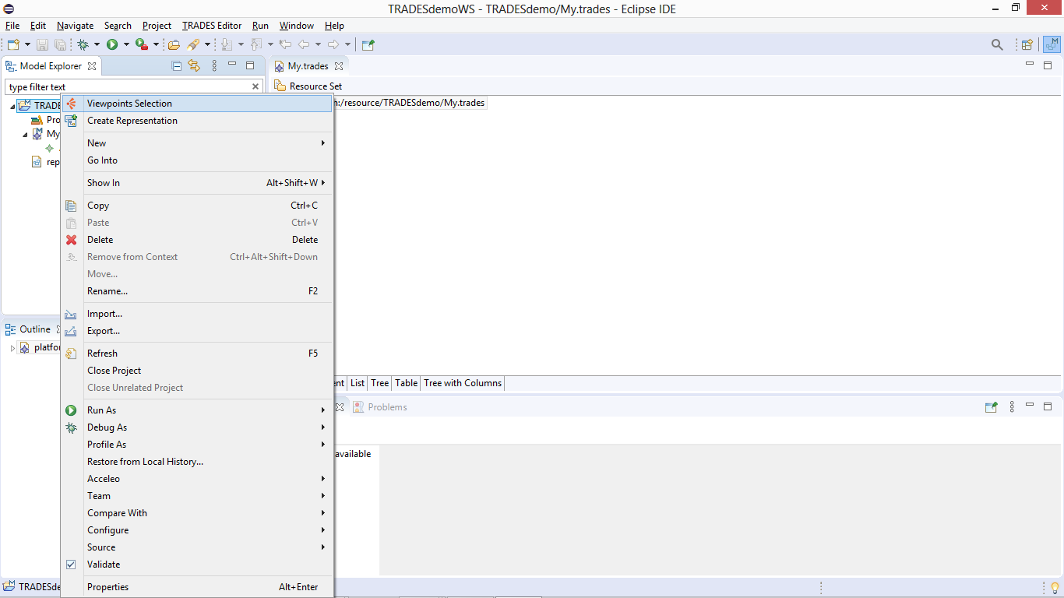
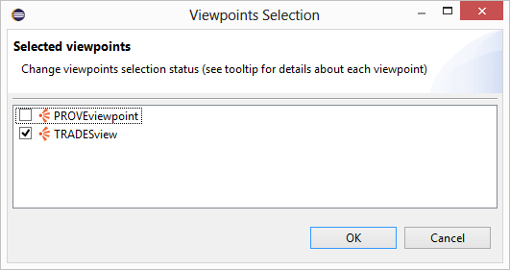
Apply the TRADESview viewpoint to the model

Slide 8
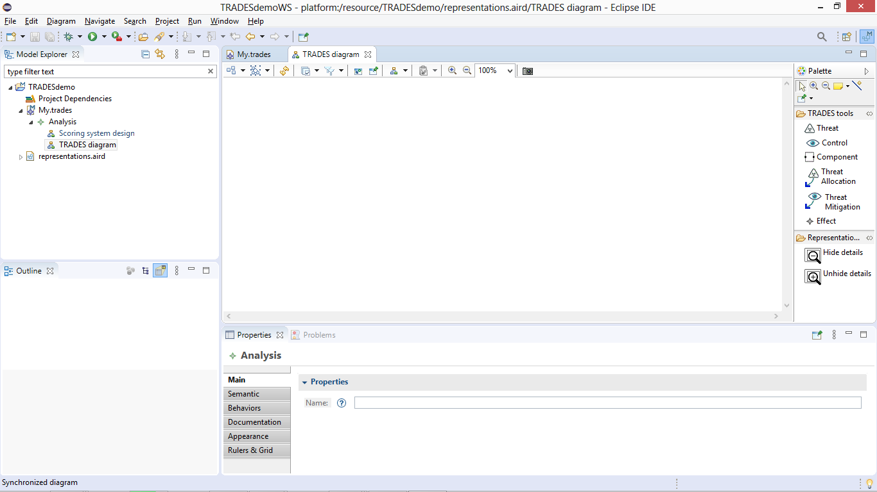
Modeling toolbox
Graphical modeling area
Navigation tree
Model element properties

Slide 9
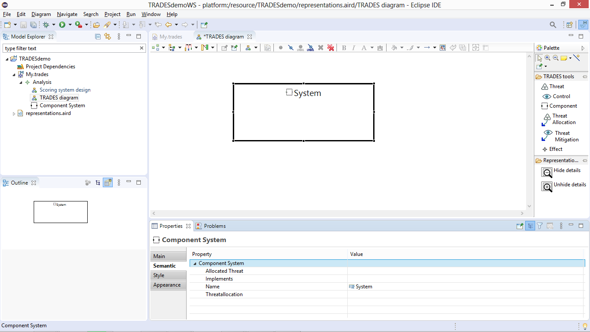
In a TRADES Diagram, use “component” to add a new physical/logical system component

Slide 10
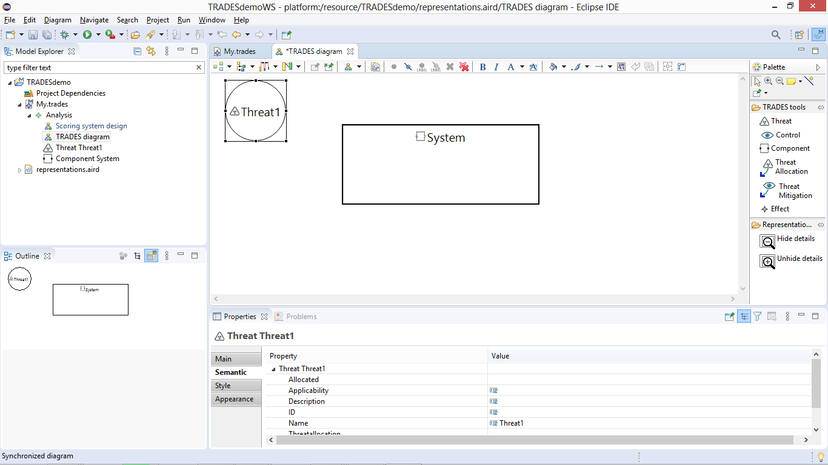
Use “Threat” to add a new threat

Slide 11
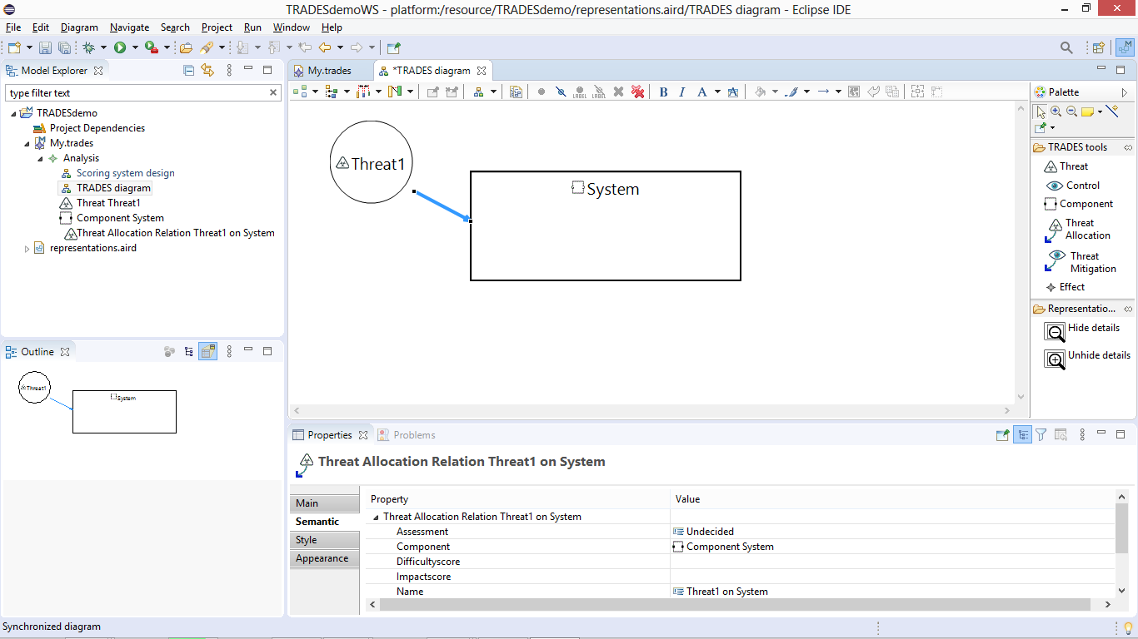
Use “Threat Allocation” to allocate a threat to a component

Slide 12
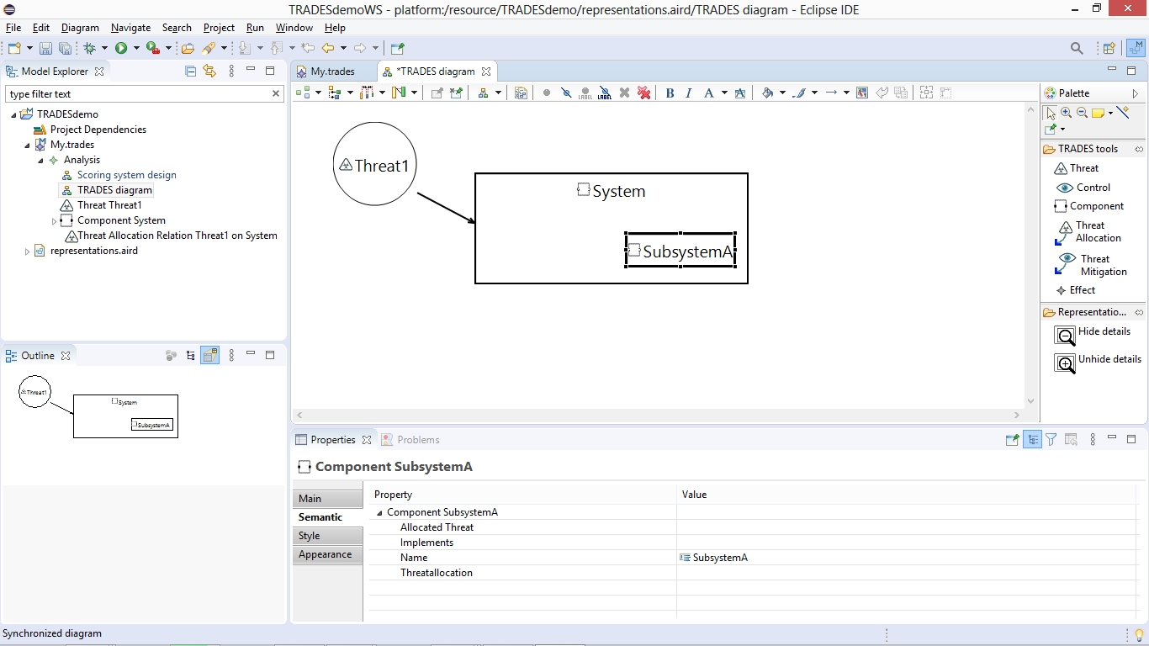
Create an additional component for a subsystem by applying “Component” tool within the “System” element

Slide 13
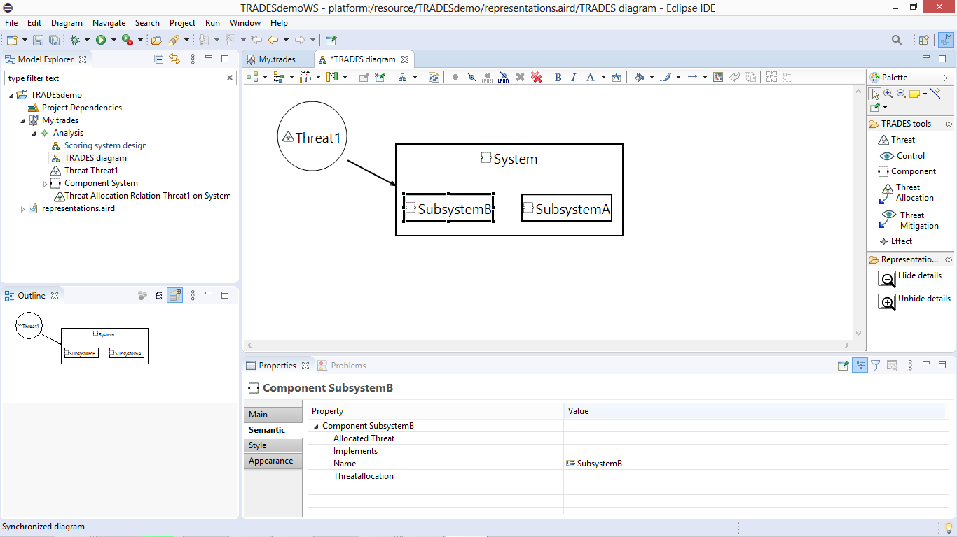
and another subsystem…

Slide 14
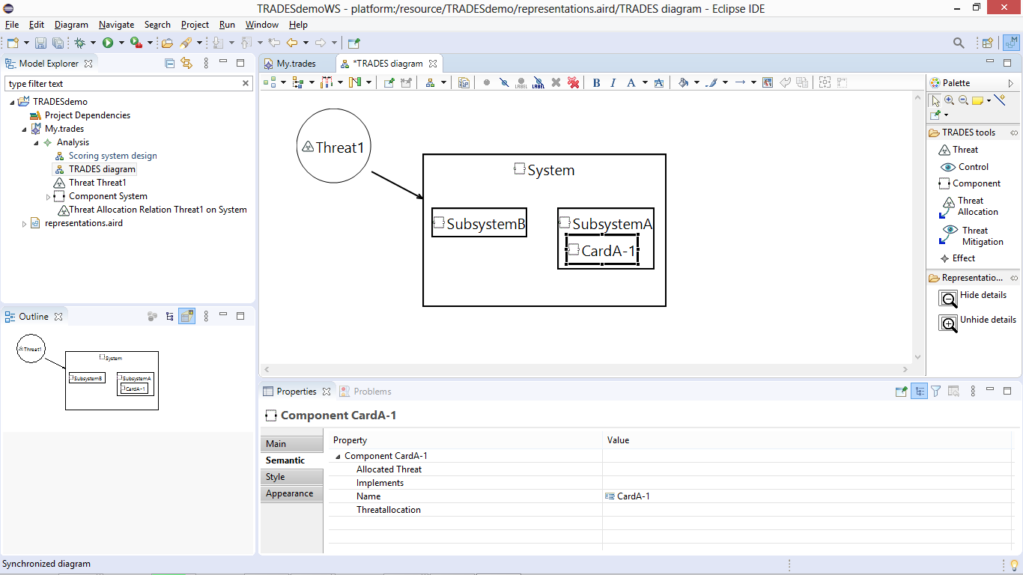
create a lower hierarchy component by applying “Component” within “SubsystemA”

Slide 15
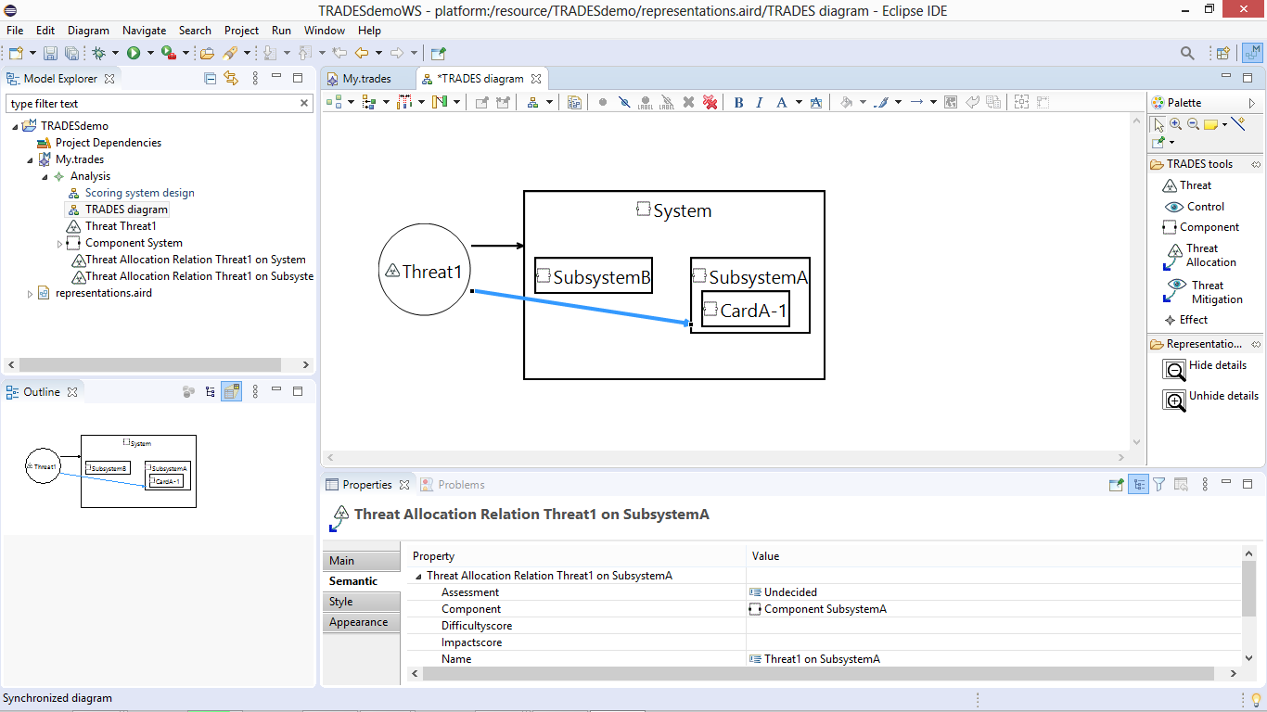
Allocate the threat to a subsystem

Slide 16
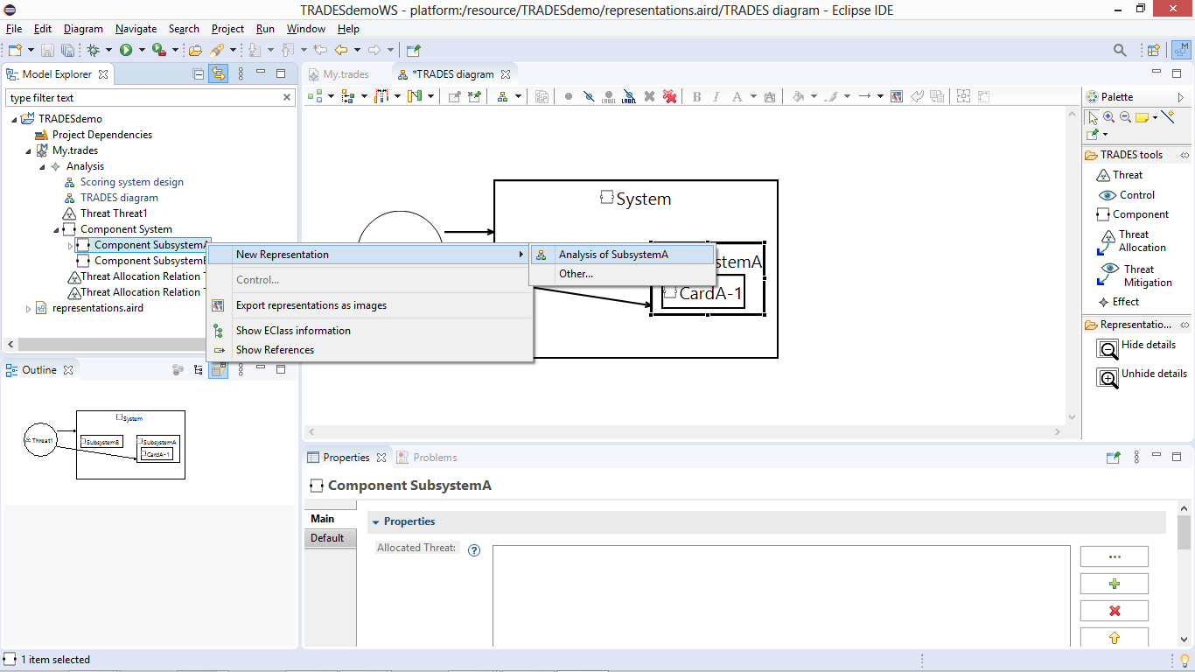
Open a new perspective for a dedicated analysis of the subsystem

Slide 17
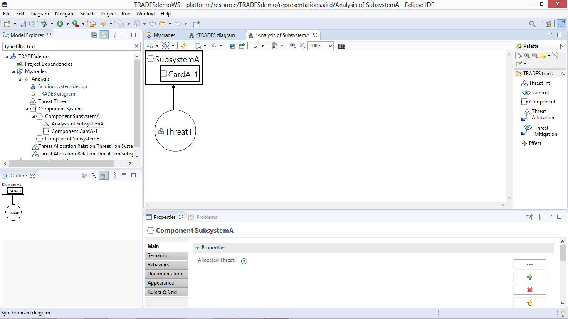
The newly created perspective is automatically synced with existing model elements

Slide 18
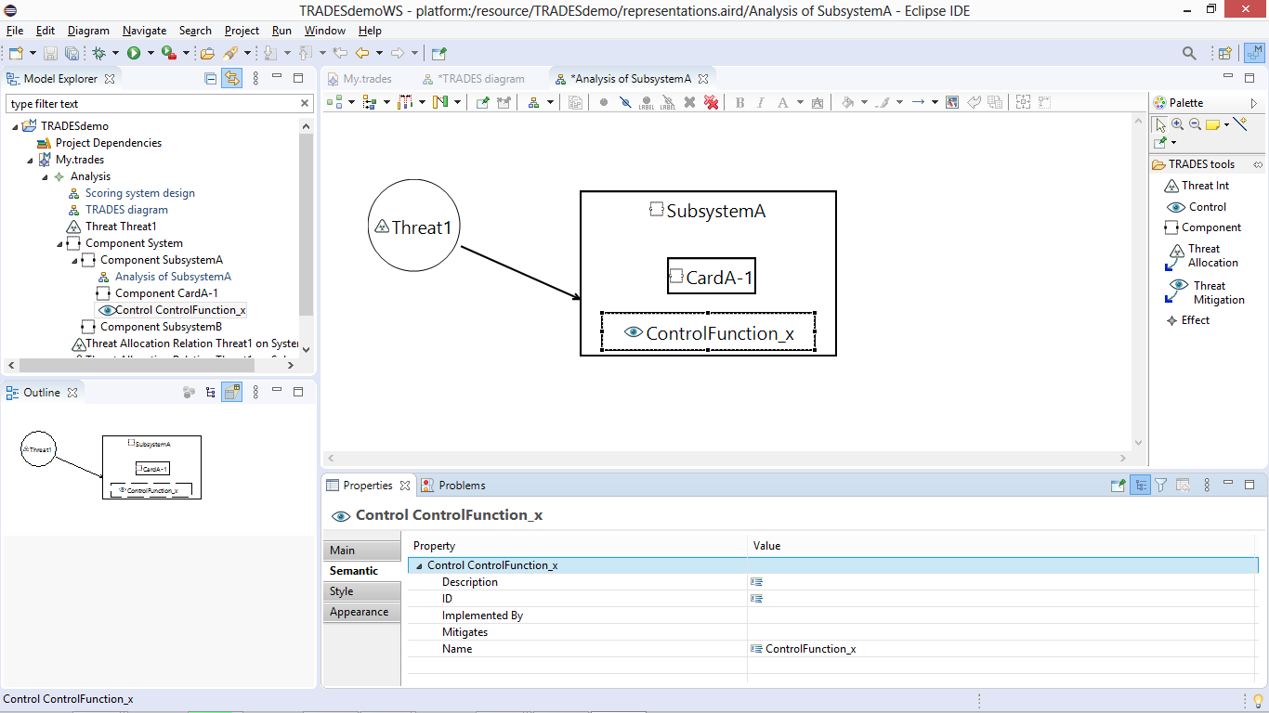
Add a security control using “Control”

Slide 19
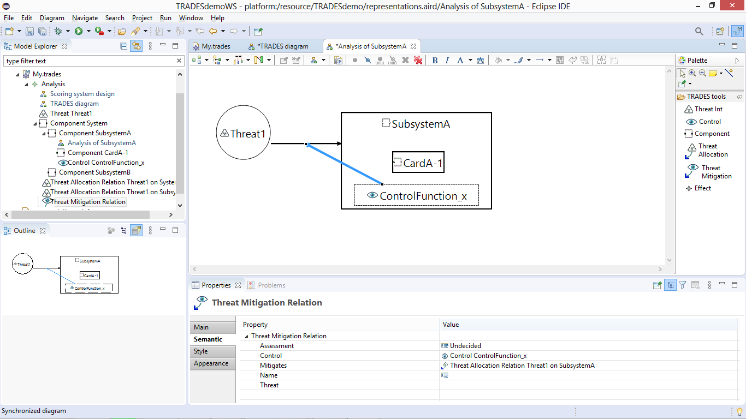
Associate the control with a threat allocation using “Threat Mitigation”, to indicate that the control mitigates the threat allocation

Slide 20
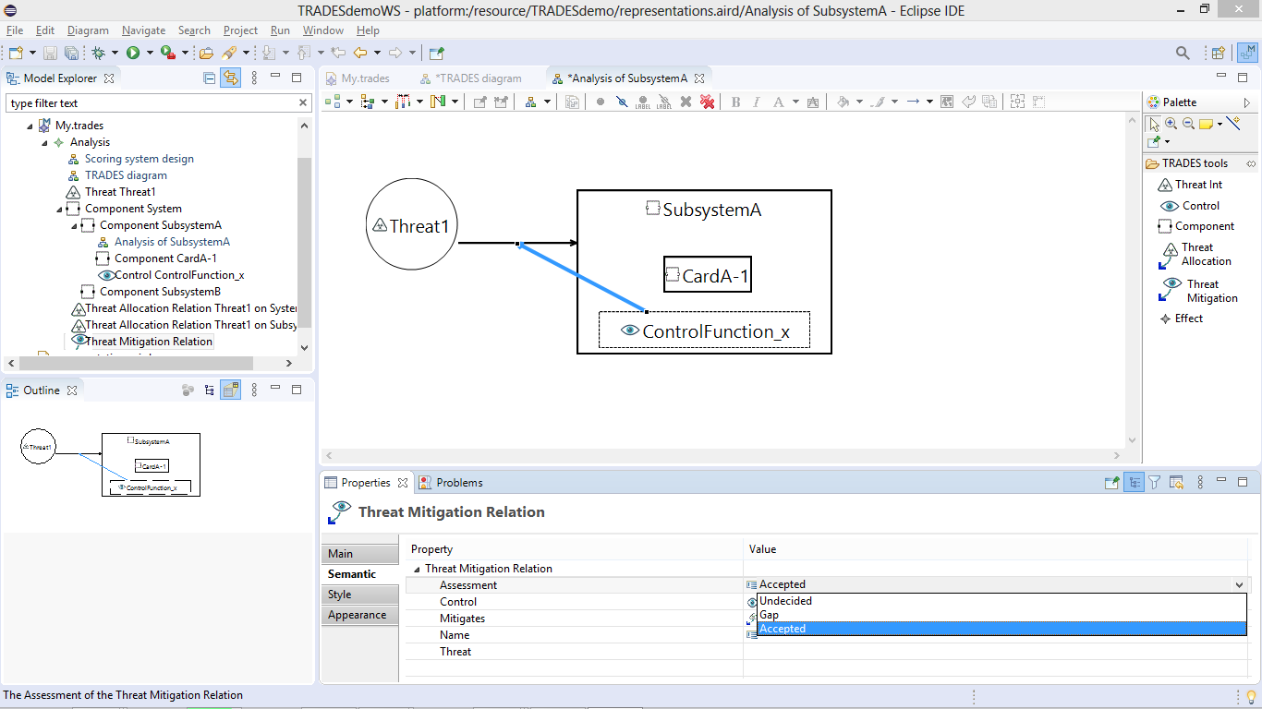
Assess if the threat mitigation is relevant

Slide 21
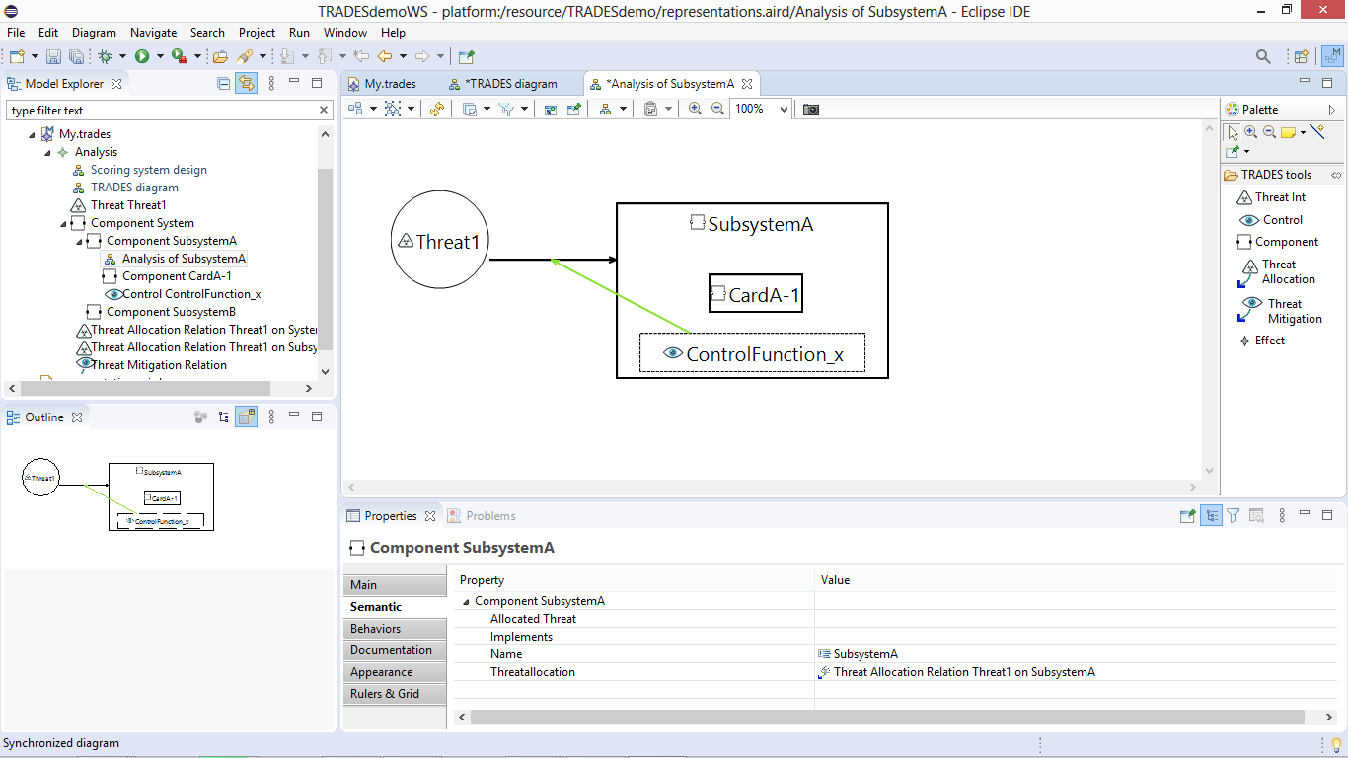
Link color changes according to decision

Slide 22
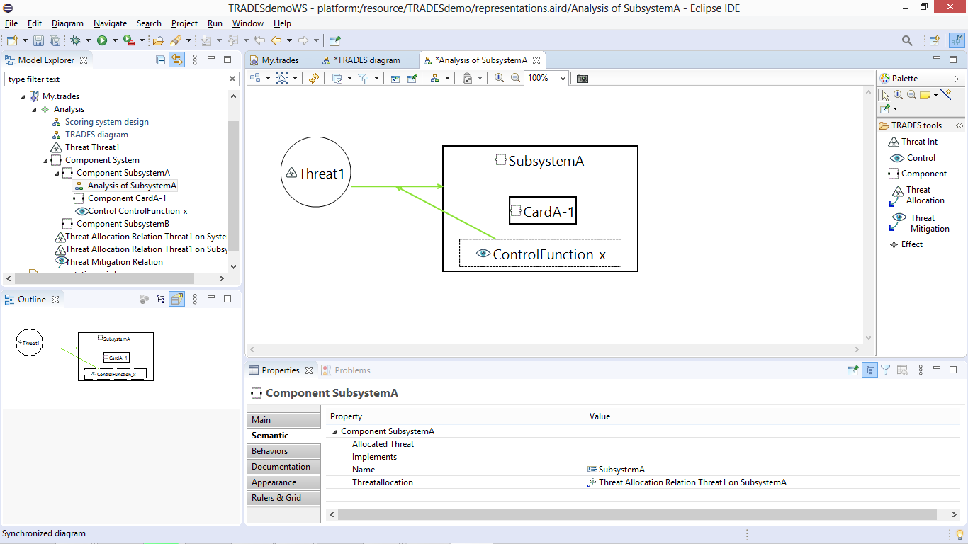
Threat allocation can now be similarly assessed (a technical/managerial decision) and reflected in the diagram

Slide 23
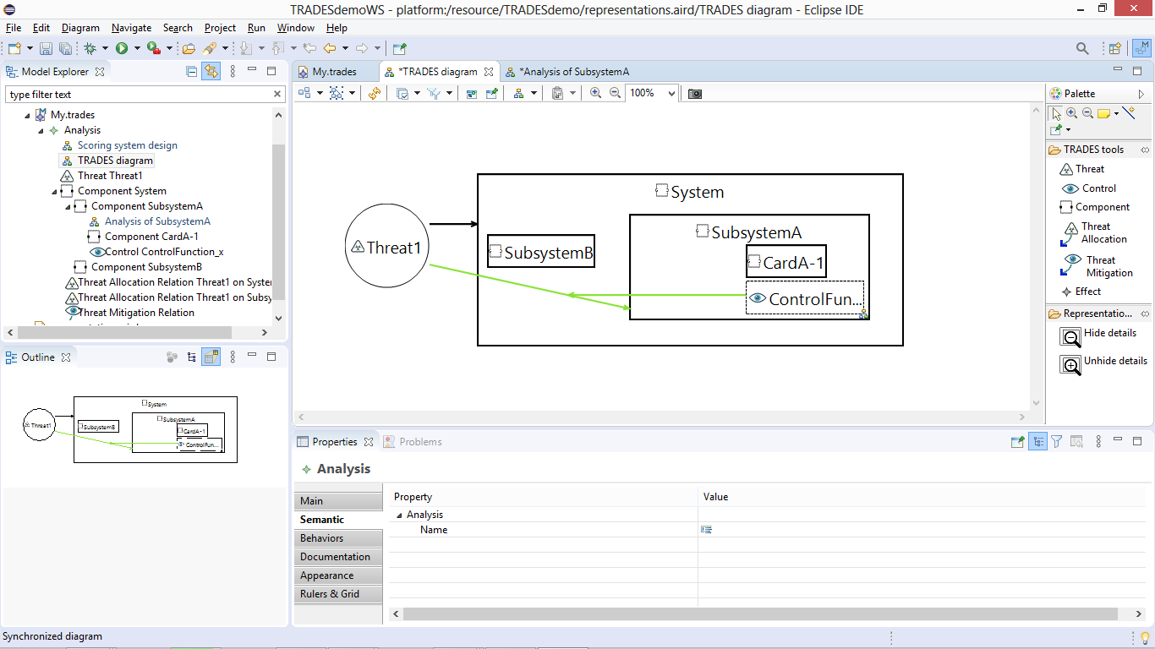
Main diagram is automatically synchronized with added elements and decisions

Slide 24
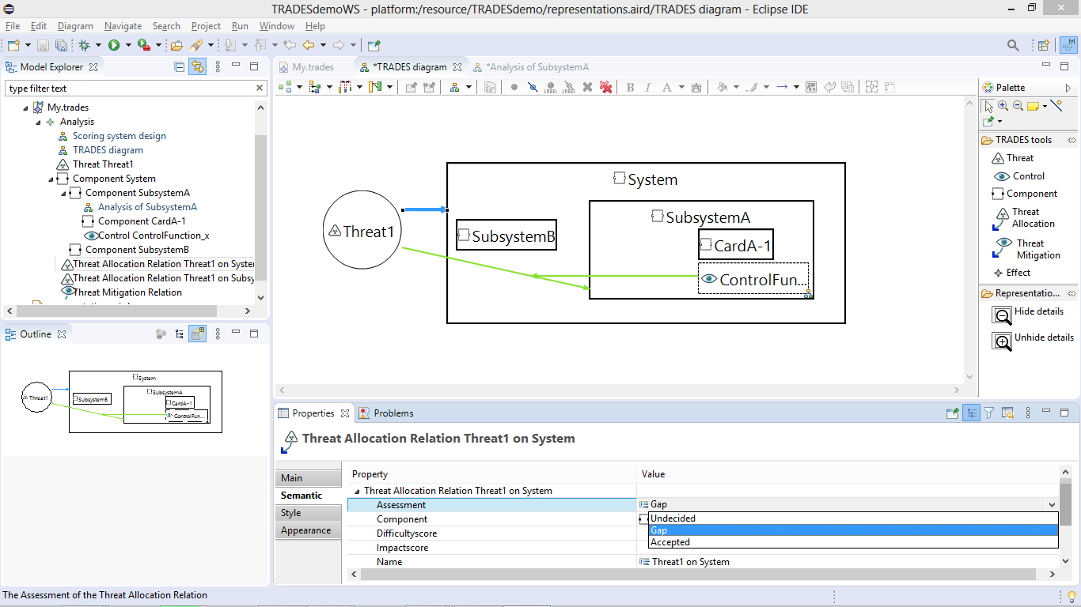
Threat allocation can be marked as a gap

Slide 25
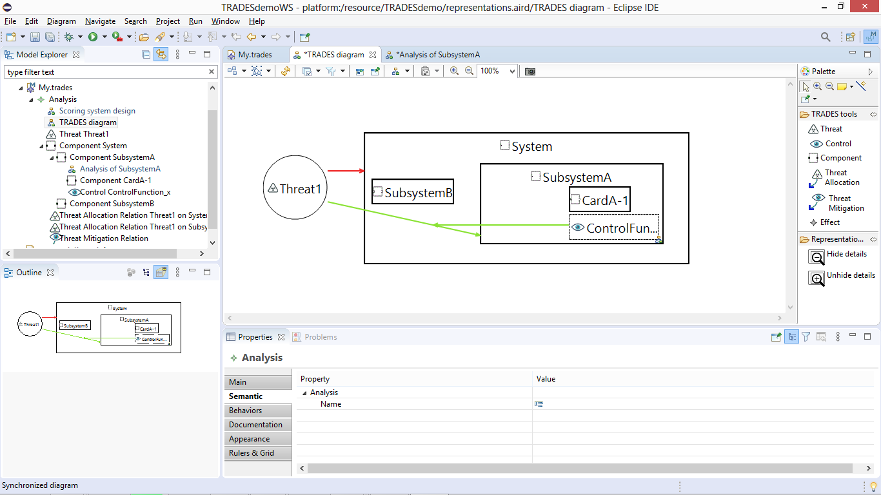
Threat allocation color is updated accordingly

Slide 26
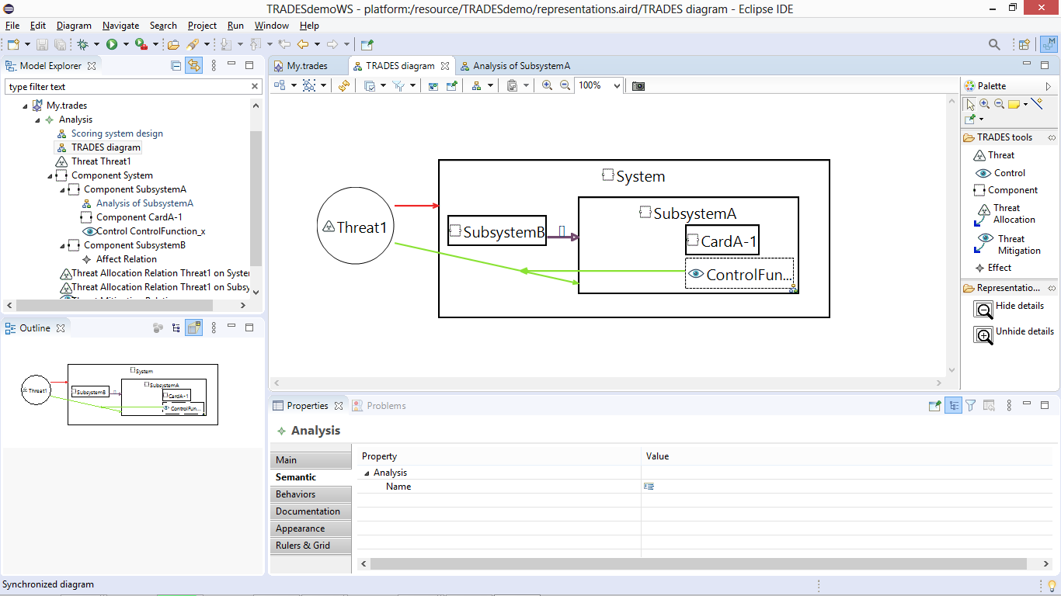
Data flow within the system can be added by using “Effect” between components

Slide 27
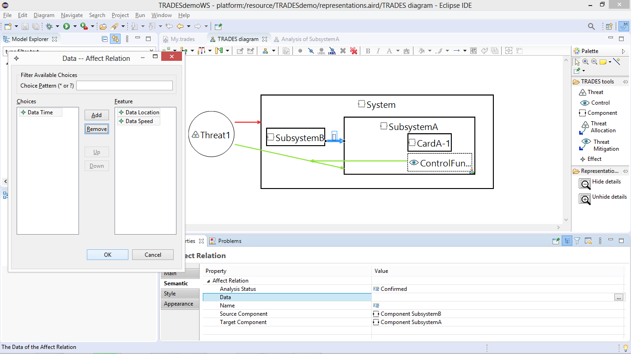
Existing or new data elements can be associated with the flow

Slide 28
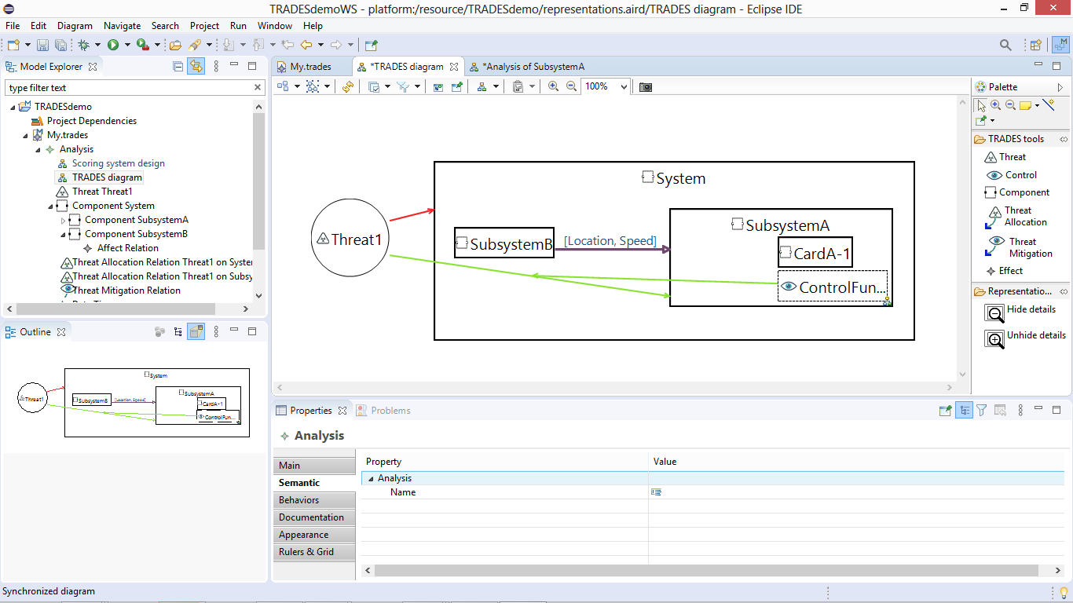

Slide 29
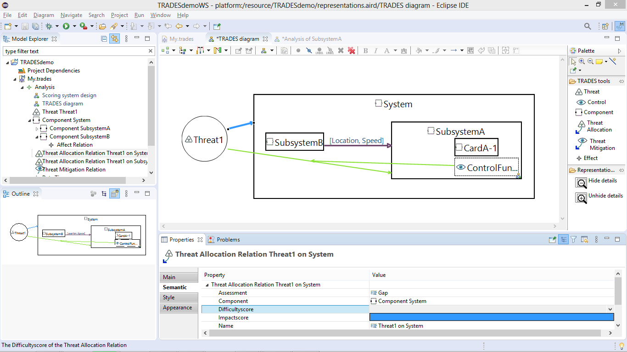
Threat allocations can be rated with difficulty and impact scores
These need to be defined in the project first

Slide 30
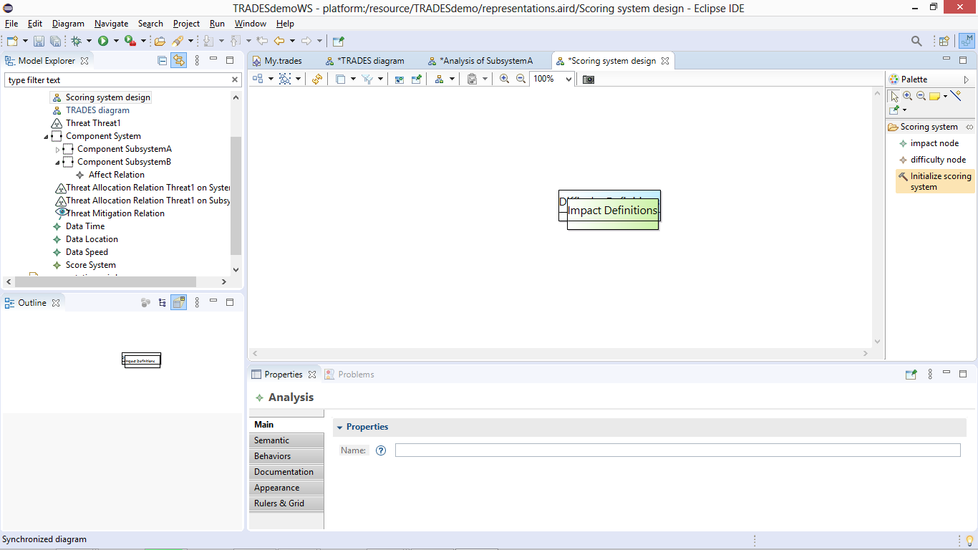
Open the “Scoring system design” diagram
Apply the “Initialize scoring system” tool to the blank diagram

Slide 31
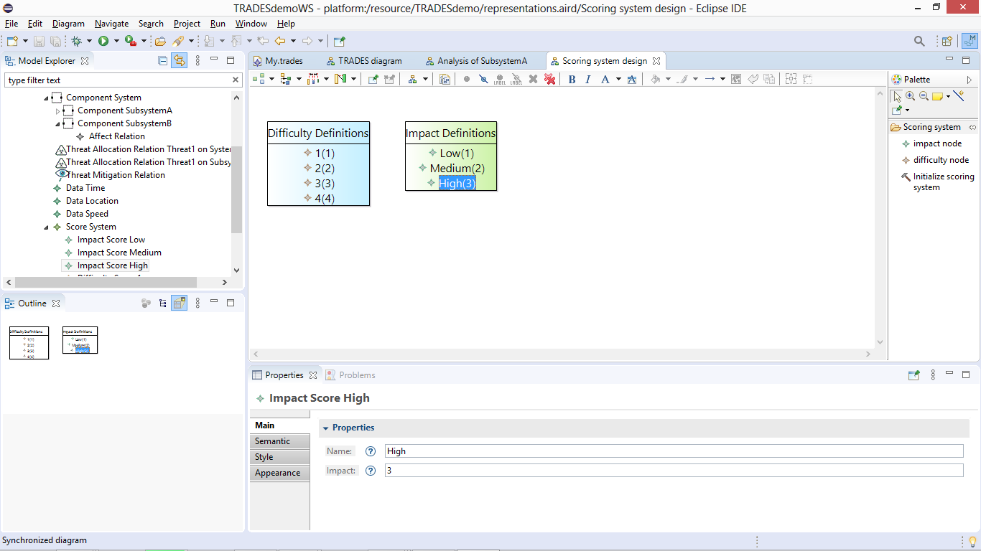
Apply “impact node” and “difficulty node” to the respective boxes to add new scoring definitions

Slide 32
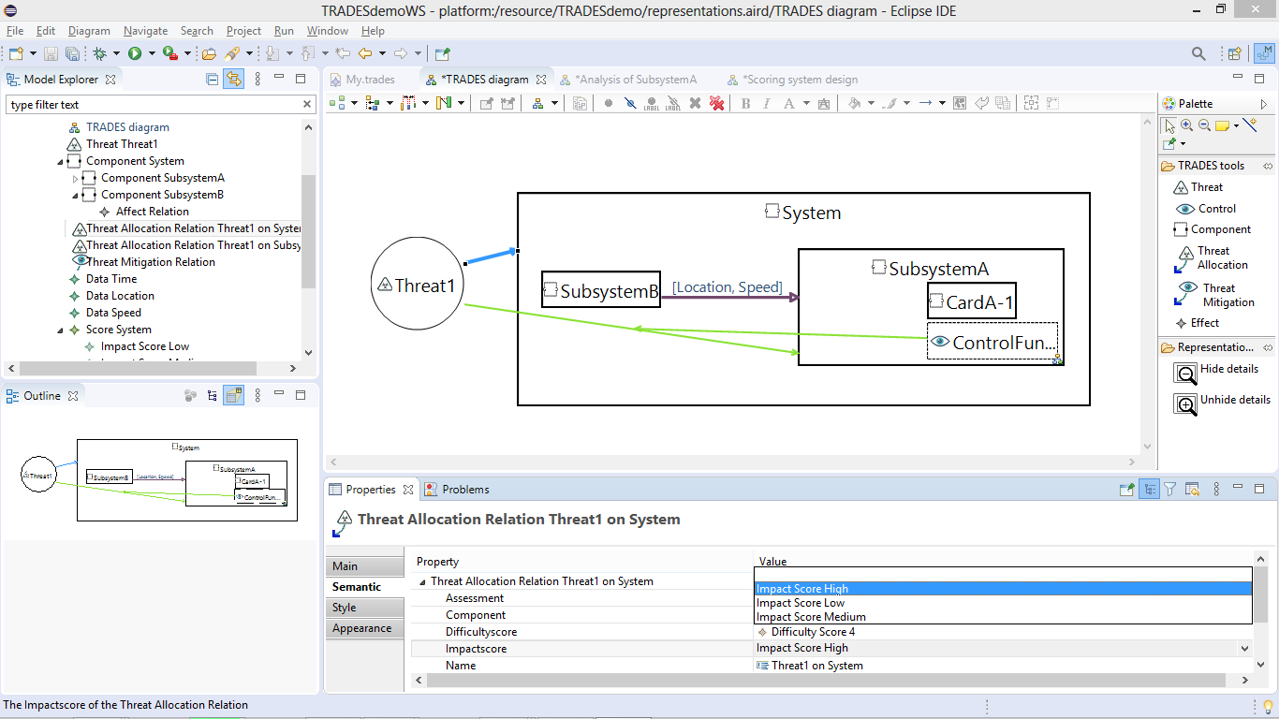
Now assess threat allocations with respect to difficulty and impact

Slide 33
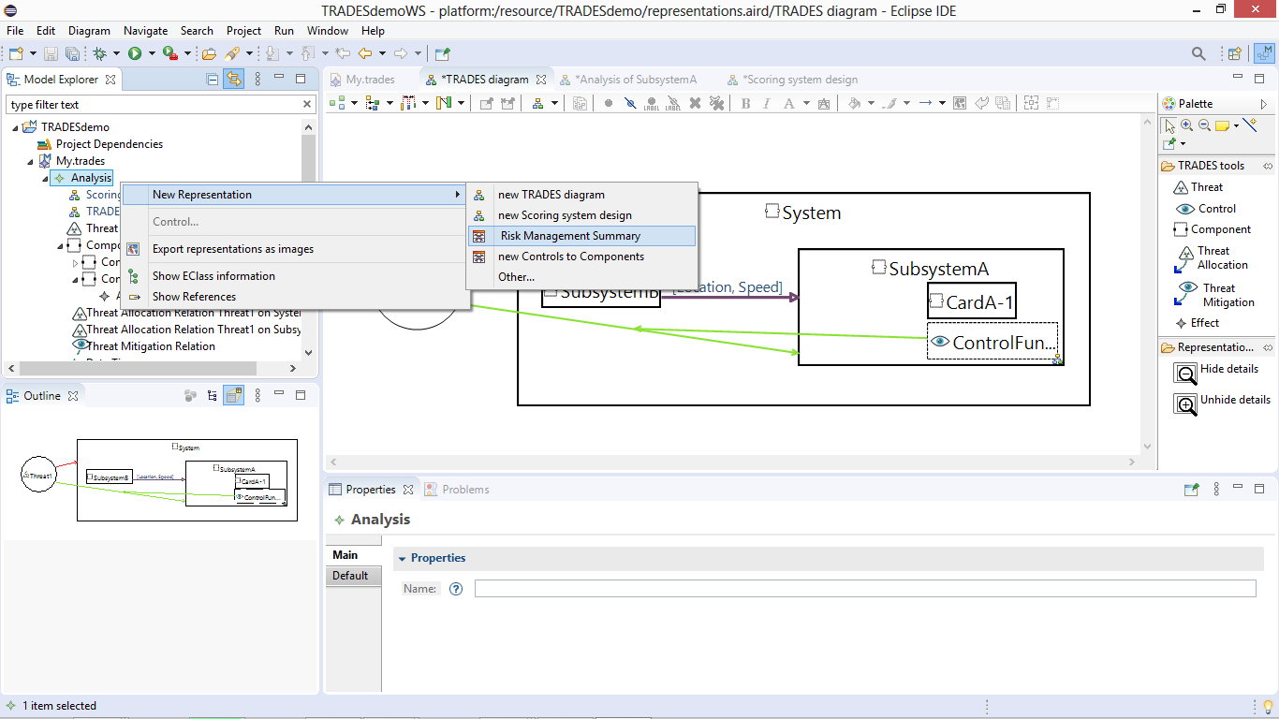
Create a risk management summary representation to view the risk assessment matrix

Slide 34
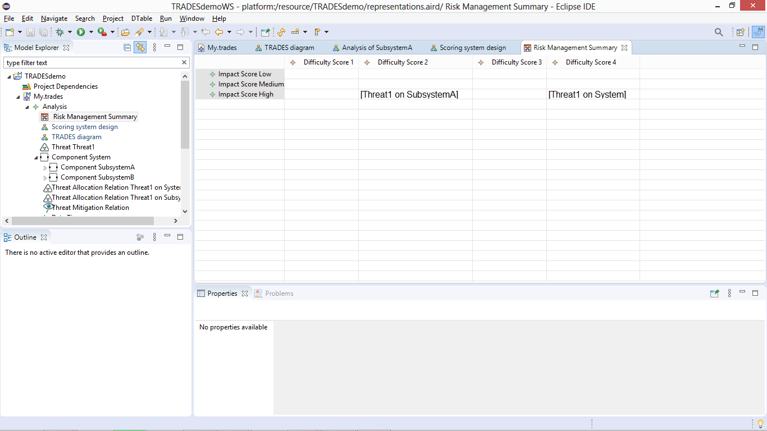
As always, the model based design of TRADES Tool assures this representation is automatically updated with every change in risk assessment

Slide 35
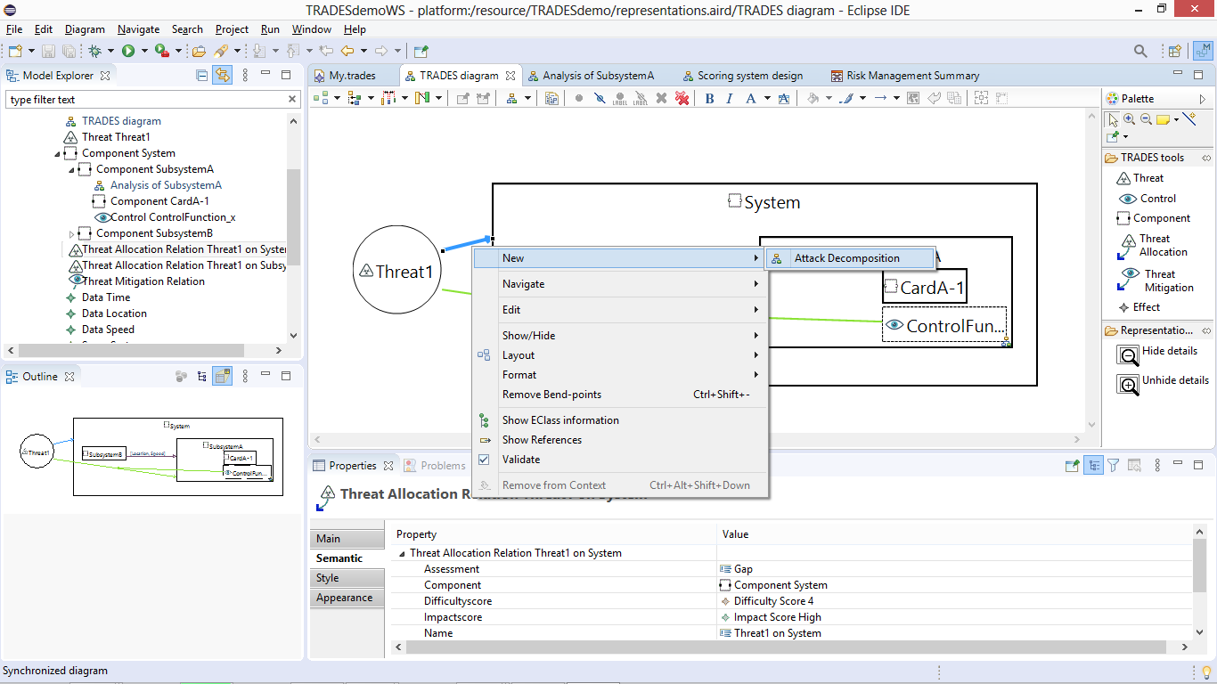
Threat allocations can be decomposed as an attack chain

Slide 36
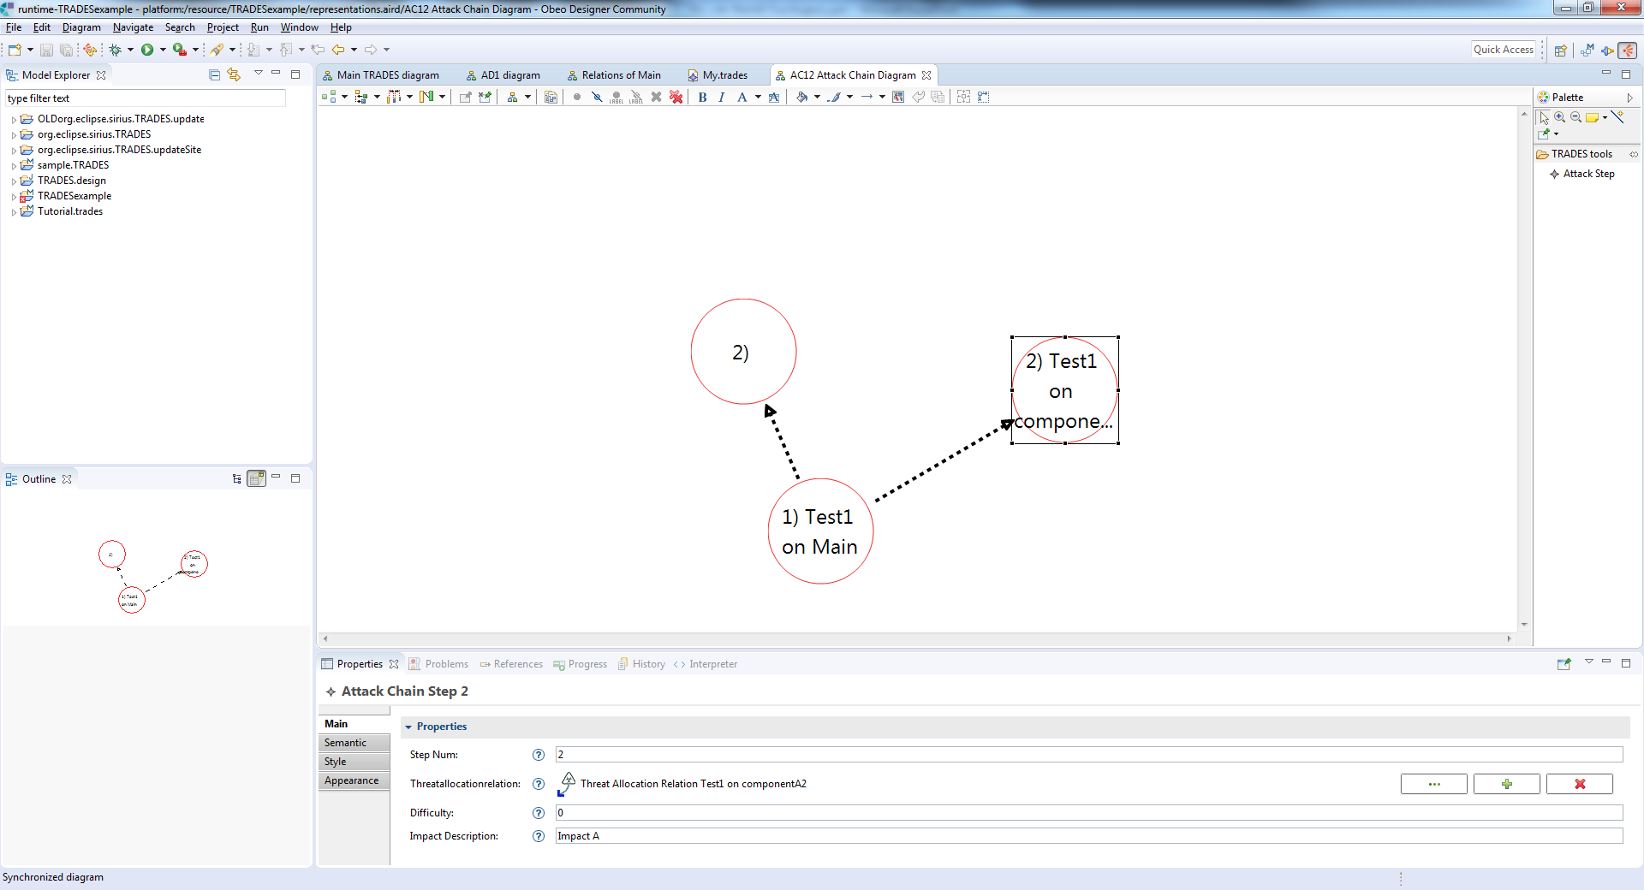
This will be detailed in the next version’s documentation

Slide 37
Summary
Elta’s Cyber Division developed a state of the art methodology and tool for cybersecurity related Threat and Risk assessment
TRADES model based approach enables design of complex systems in a coordinated and documented manner
TRADES domain specific modeling approach facilitates easy and efficient adoption
TRADES supports establishing and maintaining cybersecurity aspects of the design throughout the development and operational product lifecycle

